Slide 1

Planning a Menu For Profit

Slide 2

Sponsored by
NATIONAL
STREET FOOD
VENDORS
ASSOCIATION

Slide 3


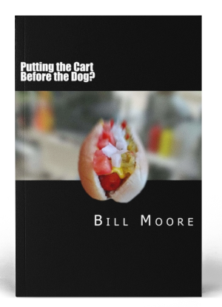
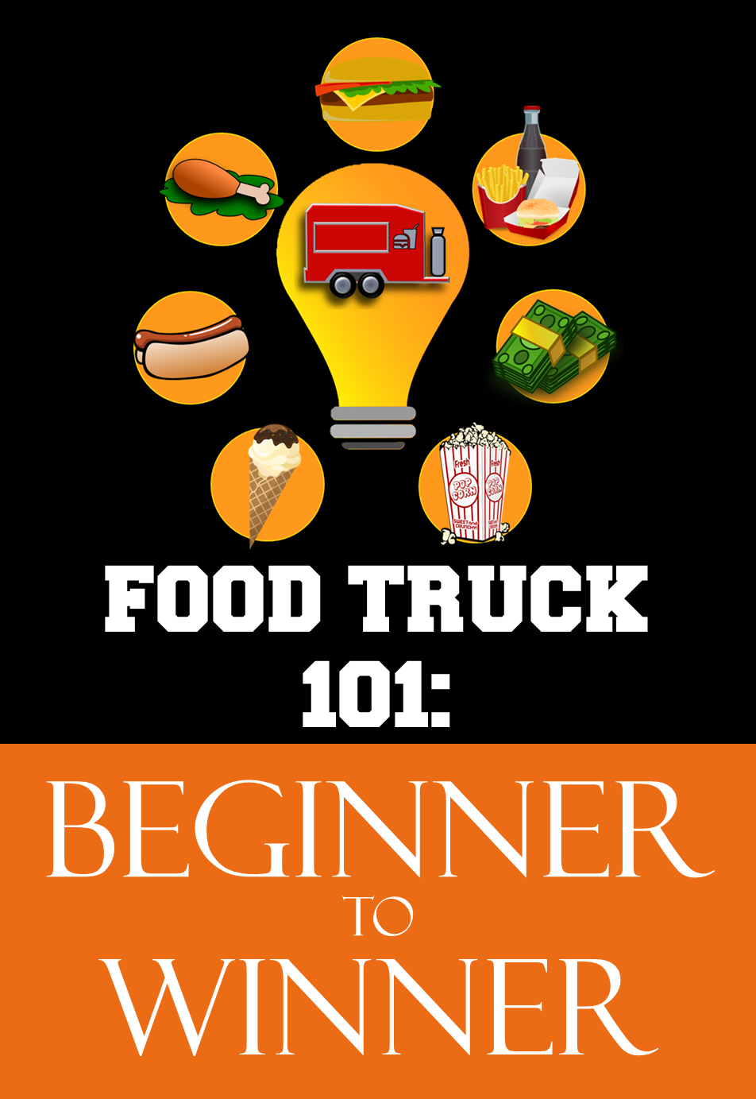

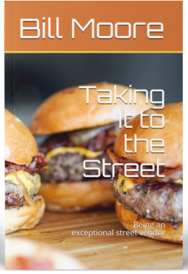

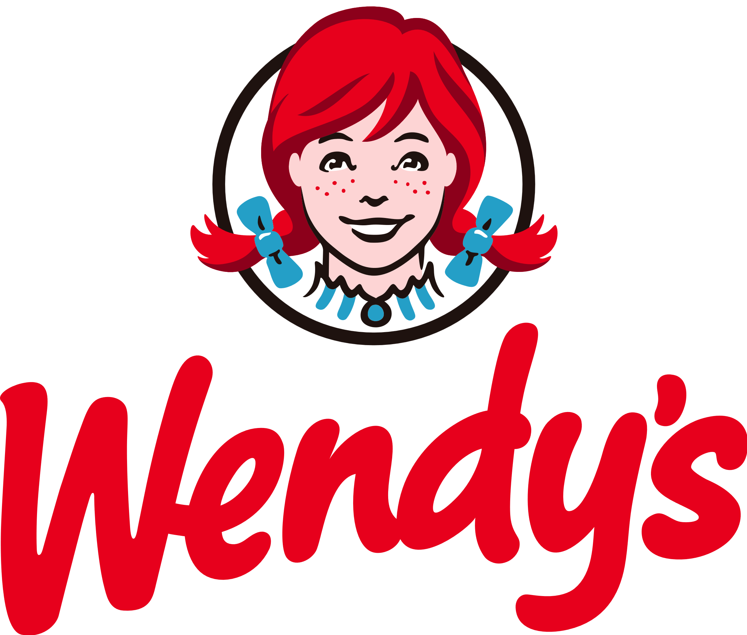



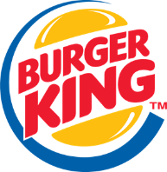








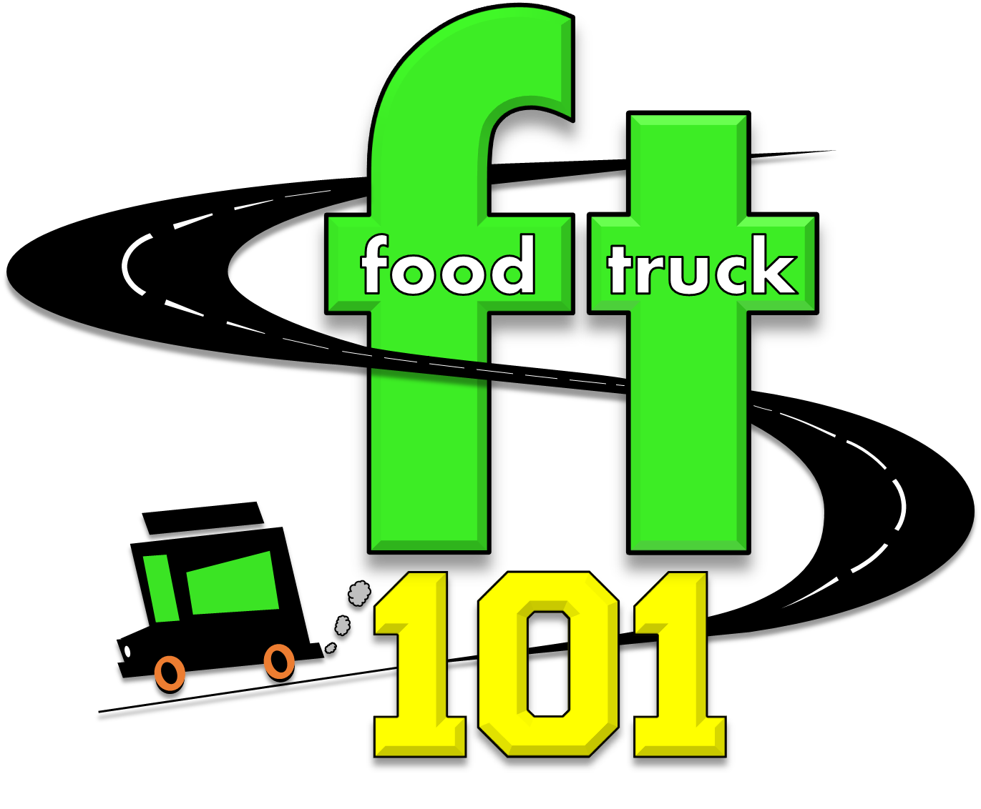

Street vendor
Author
Corporate Trainer
Executive Director
Bill Moore

Slide 4






C
FOOD COST 101
FOOD COST 101
Master
class
Master
class
FOOD TRUCK TRAINING GROUP
2023

Slide 5
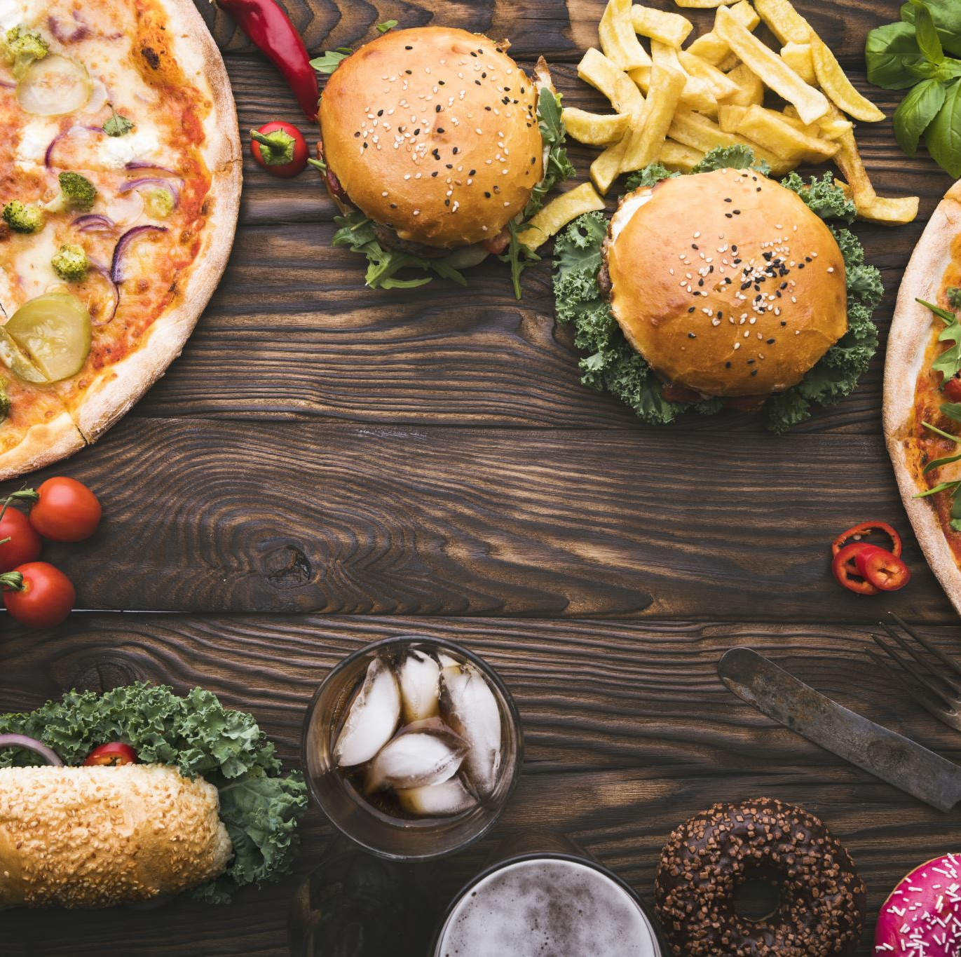
Understanding Food Cost
Single expense with 4 different but important measurements
FOOD COST 101
Recipe Cost
Actual Food Cost
Sales Mixed Theoretical Food Cost
Food Expense (invoice payment)

Slide 6

Calculating Food Cost
By Hand
By Calculator
By App
By Spreadsheet
Estimation

Slide 7
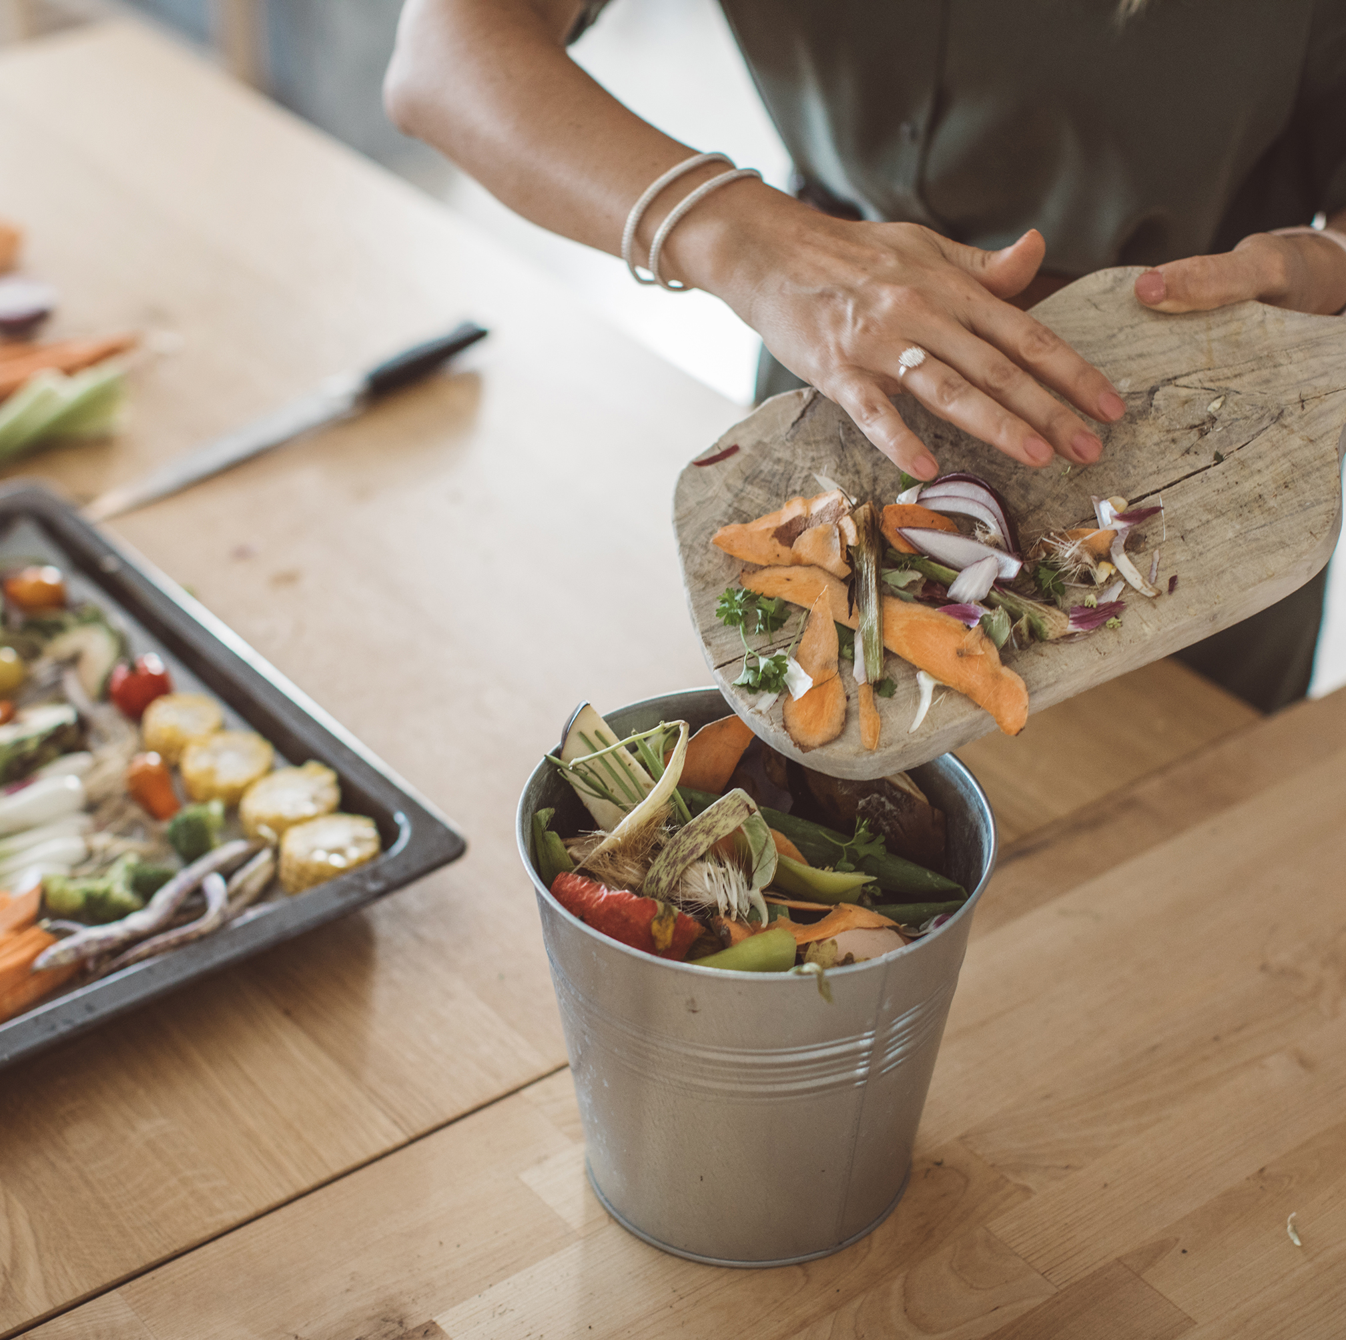
Waste Control
All Food Must Be Tracked
3 States of Food
on inventory (waiting to be sold)
on the POS (sold, discounted)
being destroyed (waste)
Cores, peels, roots – anything purchased by weight
Burnt, dropped, returns, mistakes, if it goes in the trash, it get counted

Slide 8
Ingredients
High Sales Mix
Work Horses
Stars
OTB
Puzzles
High
cost
Rule of Supply & Demand
Low
cost
?
Low Sales Mix

Slide 9
Ingredient Management
Menu Streamlining: Focus on items that share common ingredients. Your personal fave that don’t sell got to go.
High Sales Mix
Work Horses
Stars
OTB
Puzzles
High
cost
Low
cost
Inventory Tracking: Inventory tracking system to monitor ingredient levels. Get off your butt and LOOK.
Supplier Relationships: Negotiate favorable terms with suppliers to help manage costs. Buy local & cross promote for discounts.
First-In-First-Out (FIFO): Label and date EVERYTHING. Including prepped foods.
Storage and Organization: Use a well-organized shelving system to keep ingredients accessible and in good condition. In storage if you can see the walls, you have wasted space.
Low Sales Mix

Slide 10
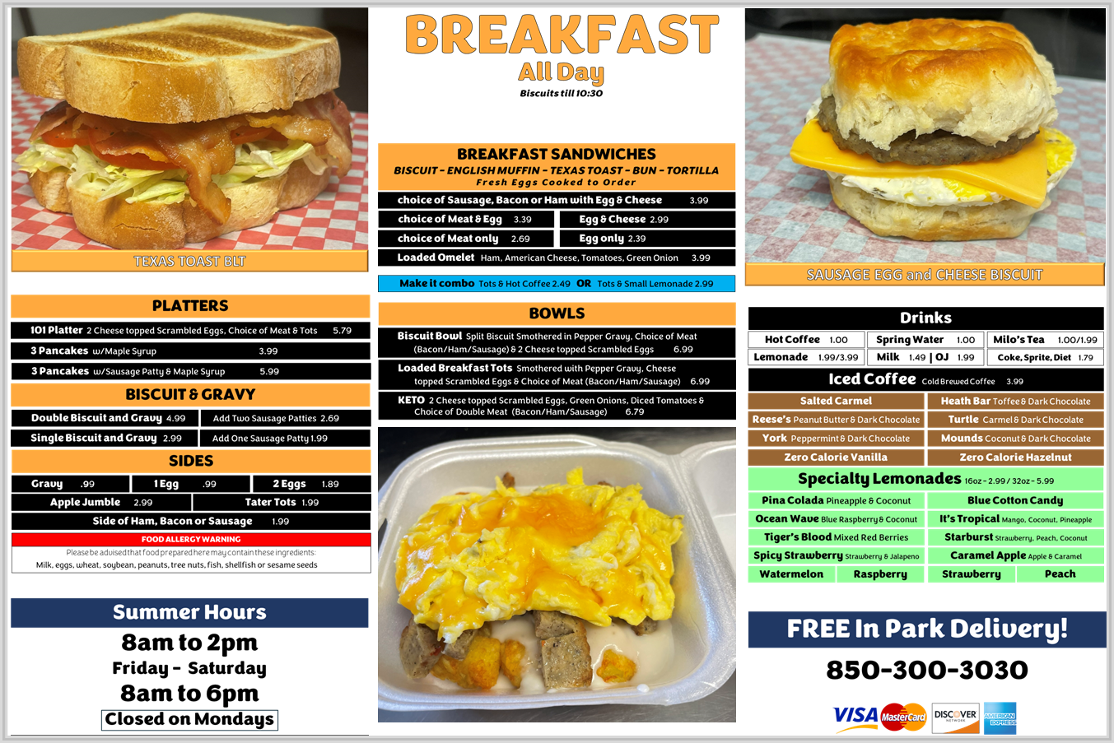
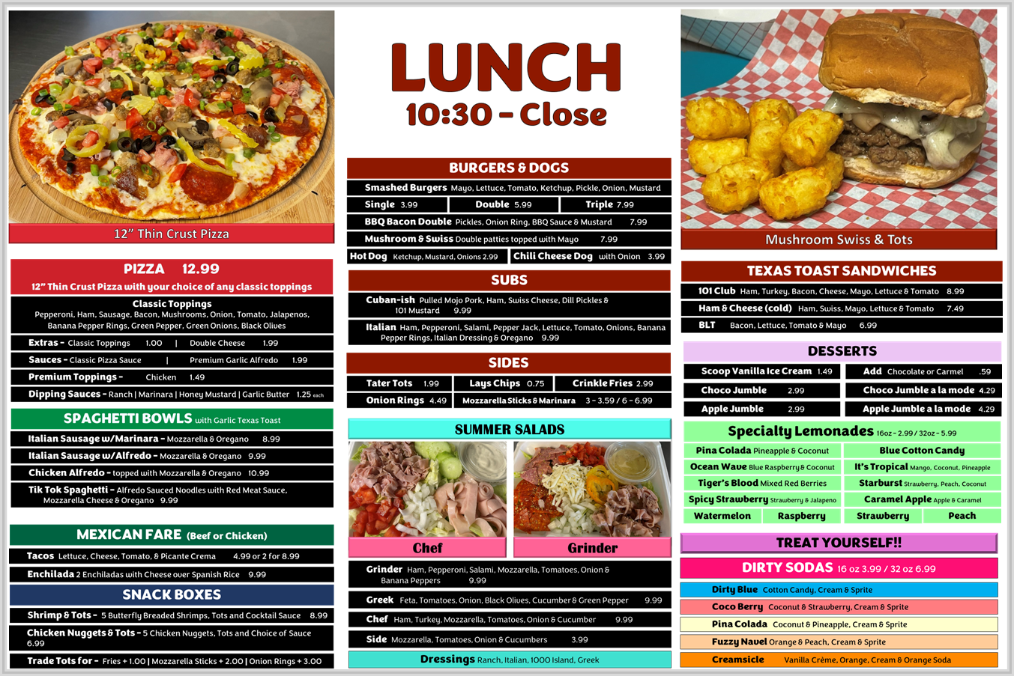

Menu Engineering
Psychology of Menu Design:
  Highlighting: Use design elements like bold fonts, colors, or graphics to draw attention to high-profit items or specials.
  Grouping: Group related items together to encourage upselling and cross-selling.
  Anchoring: Place high-profit items near expensive items to make them seem more reasonably priced in comparison..
Menu Item Placement: Position your most profitable items in the "Golden Triangle" on your menu. This is the area where guests' eyes naturally gravitate when they first look at the menu (usually the top right or center).

Slide 11
Menu Engineering
Psychology of Menu Design:
  Highlighting: Use design elements like bold fonts, colors, or graphics to draw attention to high-profit items or specials.
  Grouping: Group related items together to encourage upselling and cross-selling.
  Anchoring: Place high-profit items near expensive items to make them seem more reasonably priced in comparison..
Menu Item Placement: Position your most profitable items in the "Golden Triangle" on your menu. This is the area where guests' eyes naturally gravitate when they first look at the menu (usually the top right or center).
Monitor and Update Regularly: Replace or revamp underperforming items and adjust prices based on customer feedback, food cost changes, and sales mix trends.
Offer Limited Choices: Too many choices can overwhelm guests leading to decision fatigue. and streamline operations. Ensure each item serves a purpose and remove those that don't contribute to your pocketbook.

Slide 12

Pricing Strategies
BE = $F/(1-V%)

Slide 13
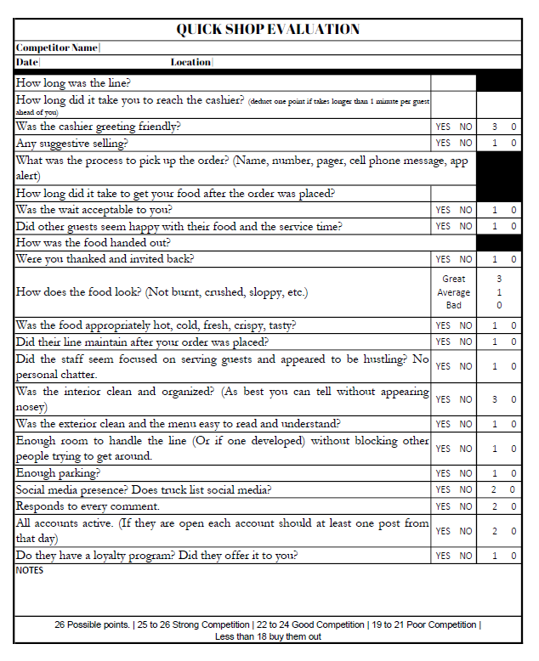
Pricing Strategies
Cost-Based Pricing: Your Food Cost must be placed in a breakeven analysis which accounts for all your other expenses
Competitive Analysis: Research other food trucks and brick-and-mortar restaurants with similar menus.
Value-Based Pricing: What do your guests perceive as value in your food. Portion, Taste, Convenience, Uniqueness.
Dynamic Pricing: Fancy business term for discounting during slow times to drive sales OR pricing based on events, festivals, or catering.
Bundle and Combo Deals: Create combo meals or bundle items to encourage customers to spend more.
Experiment and Analyze: Don't be afraid to experiment with pricing AND don’t view your pricing through your personal price tolerances.
BE = $F/(1-V%)

Slide 14
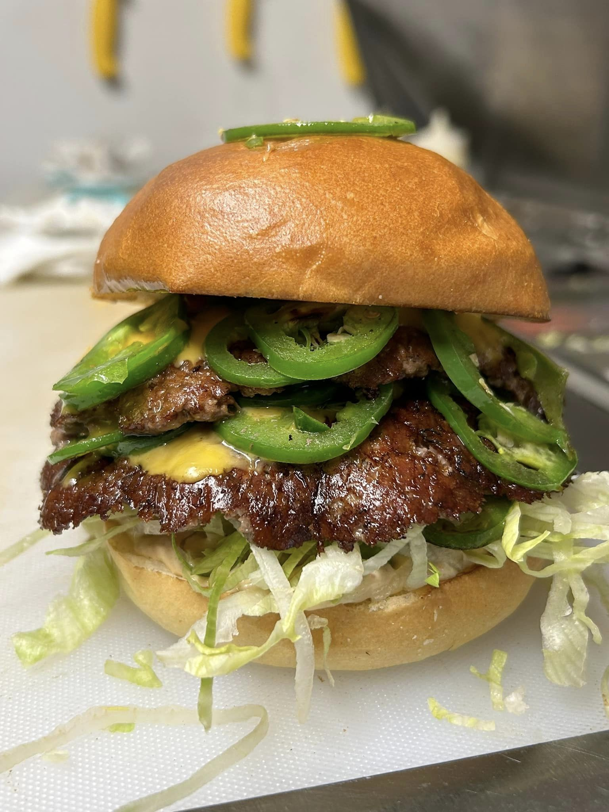

Pricing Strategies
Cost-Based Pricing: Your Food Cost must be placed in a breakeven analysis which accounts for all your other expenses
Competitive Analysis: Research other food trucks and brick-and-mortar restaurants with similar menus.
Value-Based Pricing: What do your guests perceive as value in your food. Portion, Taste, Convenience, Uniqueness.
Dynamic Pricing: Fancy business term for discounting during slow times to drive sales OR pricing based on events, festivals, or catering.
Bundle and Combo Deals: Create combo meals or bundle items to encourage customers to spend more.
Experiment and Analyze: Don't be afraid to experiment with pricing AND don’t view your pricing through your personal price tolerances.

Slide 15
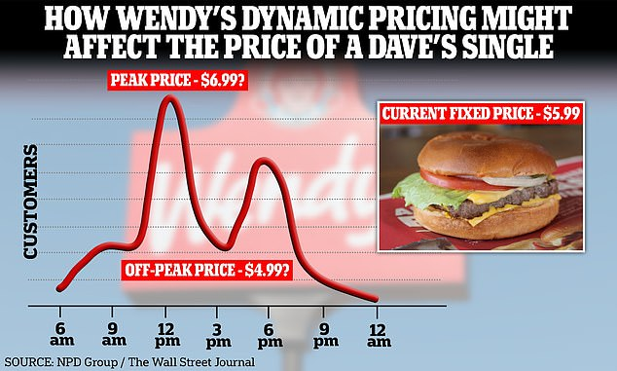
Pricing Strategies
Cost-Based Pricing: Your Food Cost must be placed in a breakeven analysis which accounts for all your other expenses
Competitive Analysis: Research other food trucks and brick-and-mortar restaurants with similar menus.
Value-Based Pricing: What do your guests perceive as value in your food. Portion, Taste, Convenience, Uniqueness.
Dynamic Pricing: Fancy business term for discounting during slow times to drive sales OR pricing based on events, festivals, or catering.
Bundle and Combo Deals: Create combo meals or bundle items to encourage customers to spend more.
Experiment and Analyze: Don't be afraid to experiment with pricing AND don’t view your pricing through your personal price tolerances.

Slide 16
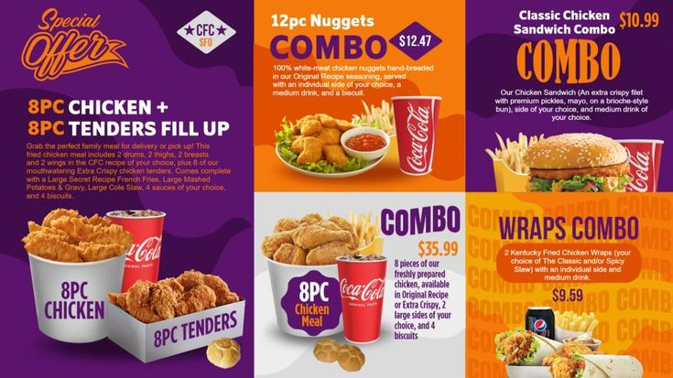
Pricing Strategies
Cost-Based Pricing: Your Food Cost must be placed in a breakeven analysis which accounts for all your other expenses
Competitive Analysis: Research other food trucks and brick-and-mortar restaurants with similar menus.
Value-Based Pricing: What do your guests perceive as value in your food. Portion, Taste, Convenience, Uniqueness.
Dynamic Pricing: Fancy business term for discounting during slow times to drive sales OR pricing based on events, festivals, or catering.
Bundle and Combo Deals: Create combo meals or bundle items to encourage customers to spend more.
Experiment and Analyze: Don't be afraid to experiment with pricing AND don’t view your pricing through your personal price tolerances.

Slide 17
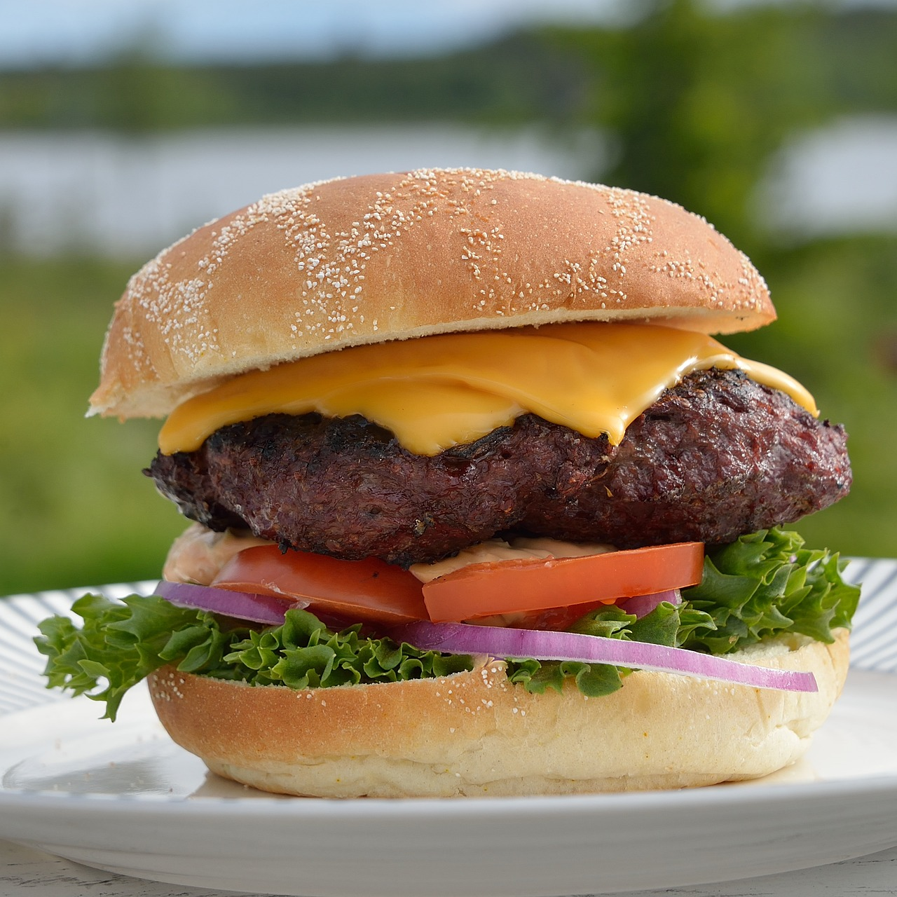
Pricing Strategies
Cost-Based Pricing: Your Food Cost must be placed in a breakeven analysis which accounts for all your other expenses
Competitive Analysis: Research other food trucks and brick-and-mortar restaurants with similar menus.
Value-Based Pricing: What do your guests perceive as value in your food. Portion, Taste, Convenience, Uniqueness.
Dynamic Pricing: Fancy business term for discounting during slow times to drive sales OR pricing based on events, festivals, or catering.
Bundle and Combo Deals: Create combo meals or bundle items to encourage customers to spend more.
Experiment and Analyze: Don't be afraid to experiment with pricing AND don’t view your pricing through your personal price tolerances.

Slide 18
Pricing Strategies
Cost-Based Pricing: Your Food Cost must be placed in a breakeven analysis which accounts for all your other expenses
Competitive Analysis: Research other food trucks and brick-and-mortar restaurants with similar menus.
Value-Based Pricing: What do your guests perceive as value in your food. Portion, Taste, Convenience, Uniqueness.
Dynamic Pricing: Fancy business term for discounting during slow times to drive sales OR pricing based on events, festivals, or catering.
Bundle and Combo Deals: Create combo meals or bundle items to encourage customers to spend more.
Experiment and Analyze: Don't be afraid to experiment with pricing AND don’t view your pricing through your personal price tolerances.
15
12

Slide 19
Understand Your Market
What is Your Target Guest: – Blue Collar, Professionals, Family, Teens, Children, Shoppers
Analyze: Local Competition, Trends & Fads
Leverage: Local Ingredients, Regional Favorites and Your Specialties
Menu Design Principles
Balance Simplicity with Perceived Variety: Three to four main lines with condiment variety.
Highlight Signature Dishes: What is your truck famous for?
Menu Layout: Golden Triangle, Colors, Boxes, Graphics
Cost Control and Pricing Strategies
Calculating Food Cost Percentage: Open Inv + Purchases – End Inv = Actual Food Cost. Then Compare to Theoretical Food Cost
Manage: Portion Control, Waste Tracking, ALL food is accounted for.

Slide 20
Guest Appeal & Experience
Craft a Menu: Must Appeal to Your Target Guest Pool
Seasonal & LTO Menu Items: Keep Guests Coming Back and Breaks Menu Fatigue
Visuals and Branding: Use Your Food in Photos, Daily Presentation Must Match Photos.
Operational Efficiency in Menu Planning
Maximize Kitchen Efficiency: Reduce 360’s and Back & Forth Motions. Time Goals for Everything!
Streamline Prep and Cooking Processes: Think Faster, Hotter, Colder, - Challenge Your Thinking.
Inventory Management: Everything Must Have a Basis in Sales Histories & Projections.
Analyze & Improve Your Menu
Solicit Feedback: Seek Reviews, Listen for Verbal Feedback, Read Social Media Comments
Analyze Sales Mix: Refine Your Menu Based on Trends in Sales Mix and Seasonality
Refresh Your Menu: Predetermine a Schedule or Trigger to add LTO’s, Drop Low Sales, Low Profit Items.

Slide 21

Q A
&

